Slide 1
Indian Ecommerce Pricing Revenue Growth Data Analysis

Slide 2
INTRODUCTION
This project focuses on analyzing Ecommerce pricing revenue sales data to understand revenue performance, customer purchasing behavior, discount impact, competition intensity, and seasonal trends.
Using Python (Pandas, Matplotlib, Seaborn), various visualizations like bar charts, line plots, heatmaps, and pie charts were created to explore patterns and trends in the dataset.
Objectives :
Explore dataset structure
Performing cleaning and Pre-processing
Generate insights from data
Visualize important trend

Slide 3
Dataset Description :
The dataset contains Ecommerce pricing revenue sales data across different states, zones, categories, and time periods. It includes sales performance, discounts, competition levels, and customer segmentation details.
Main Columns:
State & Zone – Regional sales information
Category & Brand Type – Product classification
Units Sold & Revenue – Sales performance metrics
Discount – Promotional impact
Year, Quarter, Month – Time-based analysis
Competition Intensity & Inventory Pressure – Market factors
Customer Gender – Customer segmentation

Slide 4
Dataset Cleaning:
For data cleaning process, we used different techniques based on our scenario which are
Explained in-depth as follows :
Details :
Checking for null values
Check for duplicates
Standardize the data

Slide 5
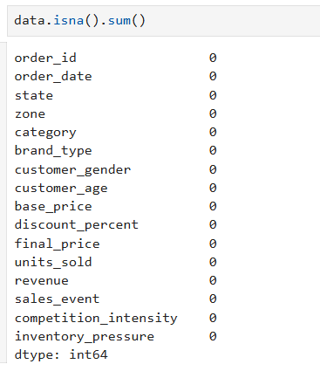
1.Checking for null values:
Here there is no null value is found

Slide 6
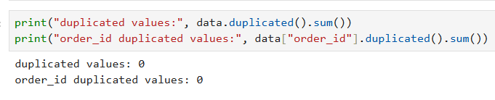
2. Checking the duplicate values :
No duplicate values are present in the dataset.

Slide 7
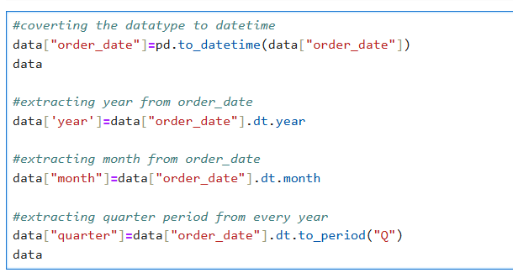
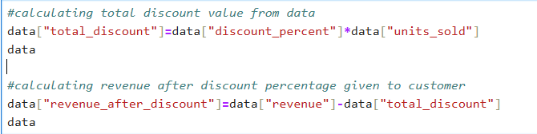
3. Standardize the data :
Covert to datetime format
Extract year, month, quarter period and create a new column
Calculate total discount from data and added a new column
Calculate revenue after discount given to customer and added a new column

Slide 8
Exploratory data analysis :
For the data analysis purpose, I followed the below steps to analyse the data and provide
Insights and visualization
Process :
Summary statistics
Analysis Visualization
Providing insights

Slide 9
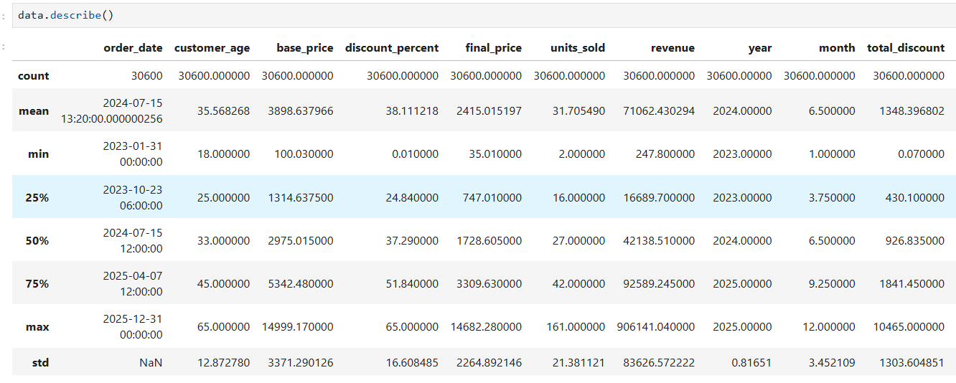
A. SUMMARY STATISTICS
It helps you to quickly understand the overall distribution of your data.
They show key measures like mean, median, count, min, max, and standard deviation.
This helps in identifying trends, outliers, and data quality issues before analysis.

Slide 10
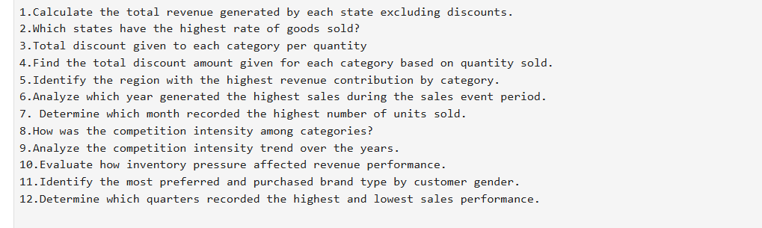
b. Analysis visualization
Framing the right questions helps us find insights through analysis.
By answering those questions, we can discover meaningful patterns and conclusions from the data.

Slide 11
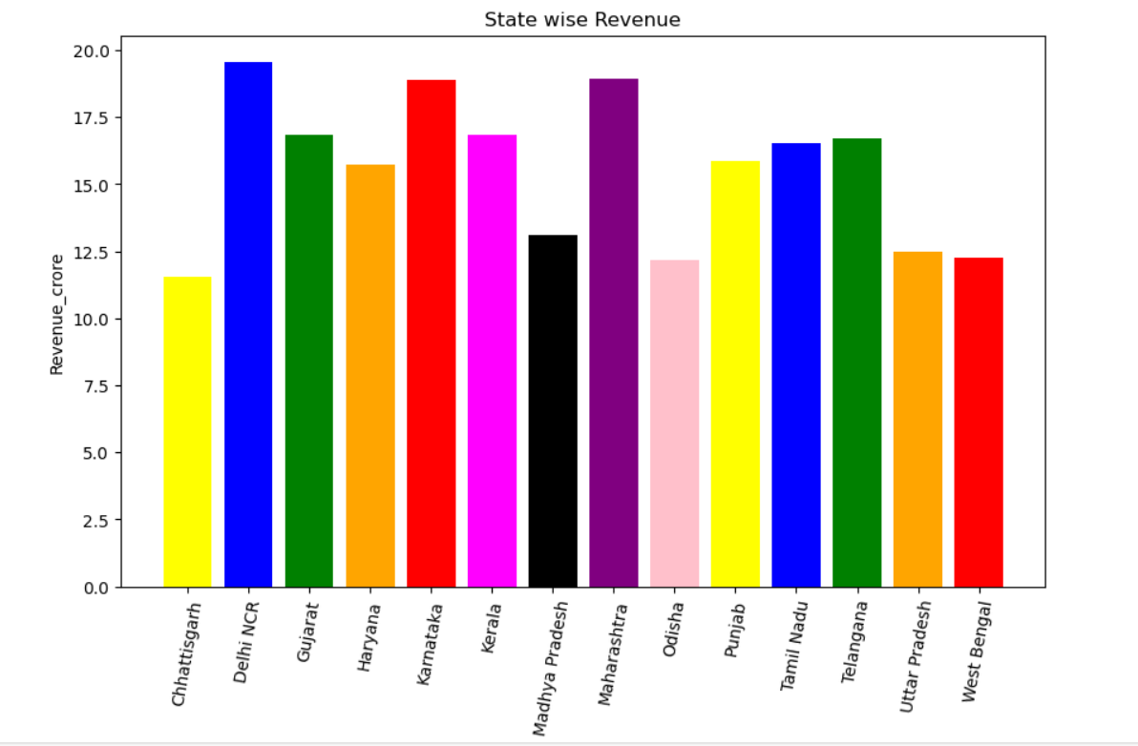
b1. Calculate the total revenue generated by each state excluding discounts.
Delhi NCR records the highest revenue, followed closely by Maharashtra and Karnataka.
Chhattisgarh shows the lowest revenue, with Odisha and West Bengal also among the lower-performing states.

Slide 12
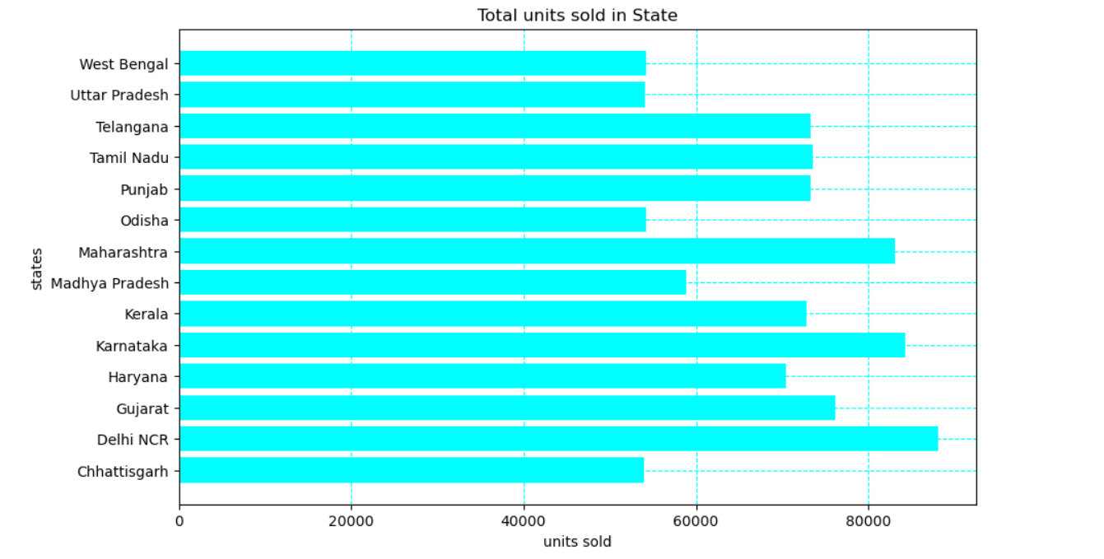
b2. Which states have the highest rate of goods sold?
Delhi NCR has the highest units sold, followed by Karnataka and Maharashtra.
Chhattisgarh and Uttar Pradesh record the lowest sales among the listed states.

Slide 13
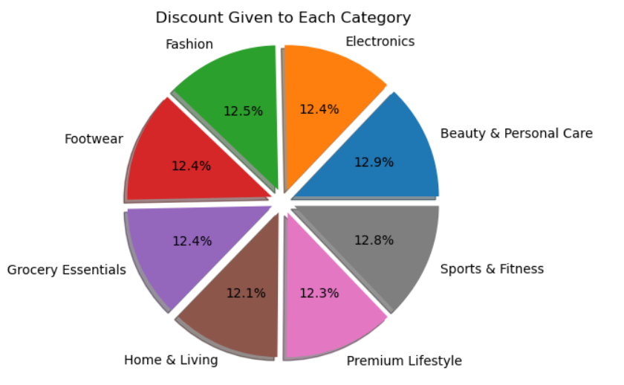
B3. Total discount given to each category per quantity
Discount distribution is almost evenly spread across all categories, with no major variation.
Beauty & Personal Care has the highest share, while Home & Living has the lowest discount percentage.

Slide 14
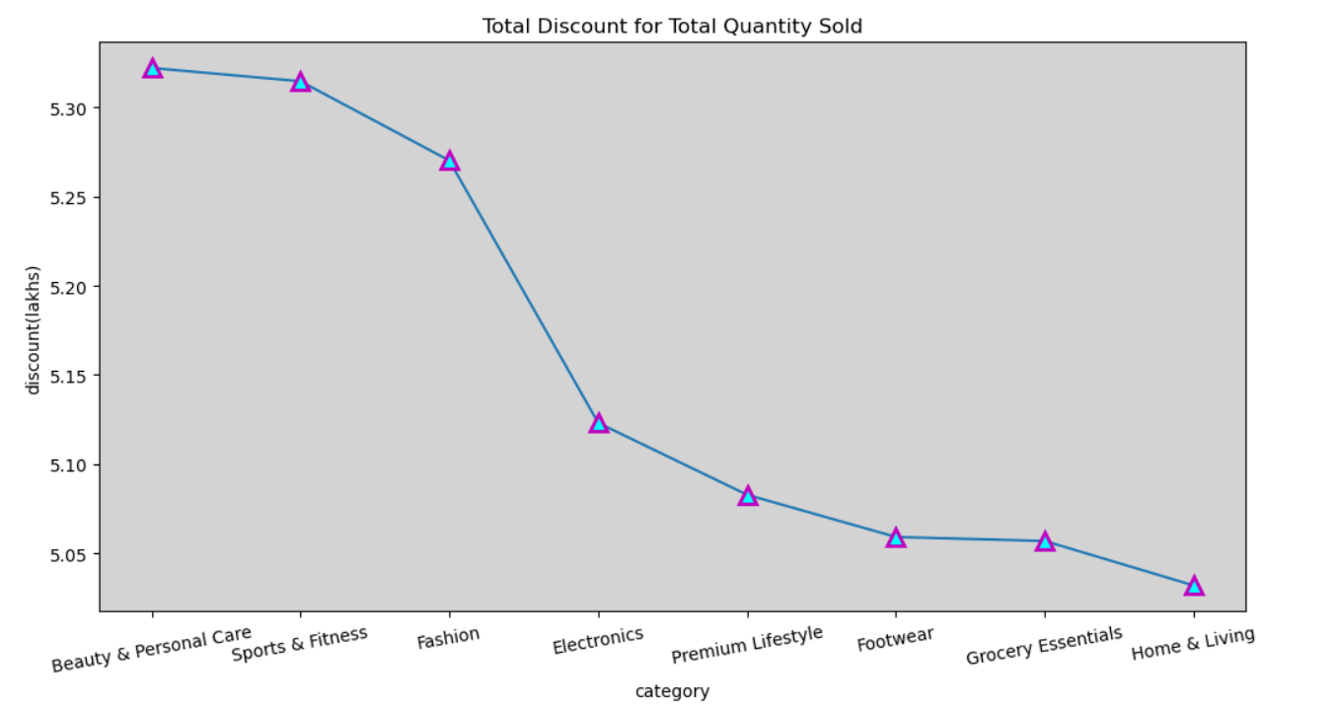
B4. Find the total discount amount given for each category based on quantity sold.
Categories with higher quantity sold is Beauty & Personal care tend to receive higher overall discounts.
Indicates volume-based discount strategy.

Slide 15
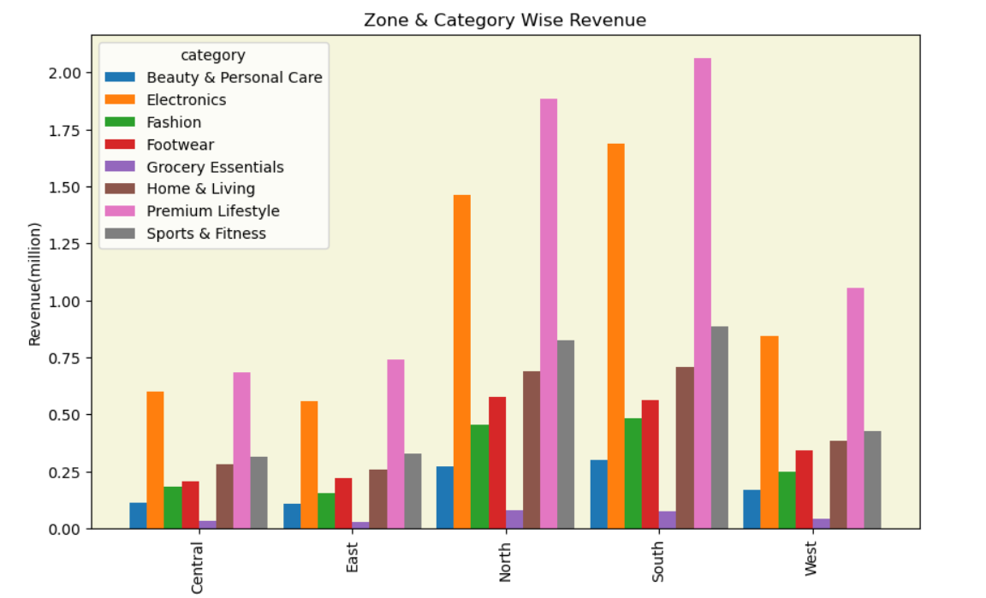
B5. Identify the region with the highest revenue contribution by category.
South zone generates the highest revenue across most categories, especially in Premium Lifestyle and Electronics.
East and Central zones show comparatively lower revenue, while North performs moderately strong.

Slide 16
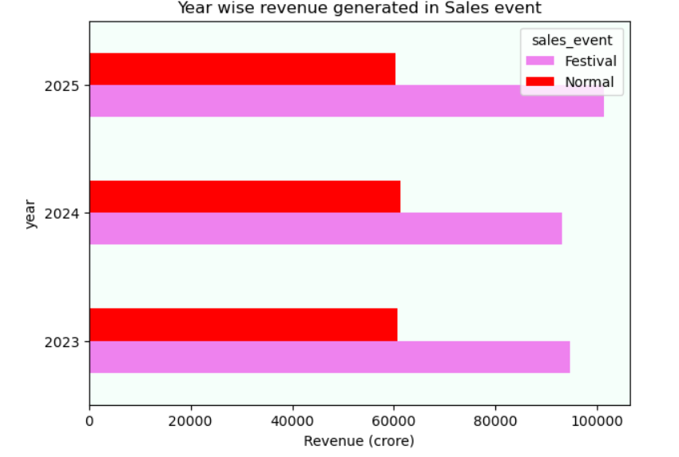
B6. Analyze which year generated the highest sales during the sales event period.
Sales events significantly contribute to yearly revenue.
2025 shows stronger performance, indicating improved event strategy or higher customer engagement.

Slide 17
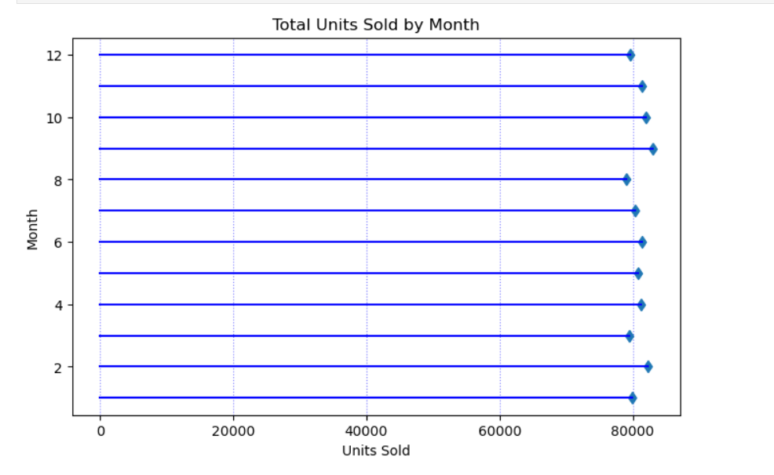
B7. Determine which month recorded the highest number of units sold.
Monthly sales fluctuate across the year.
2 and 9 months show peak sales, possibly due to seasonality or promotional campaigns.

Slide 18
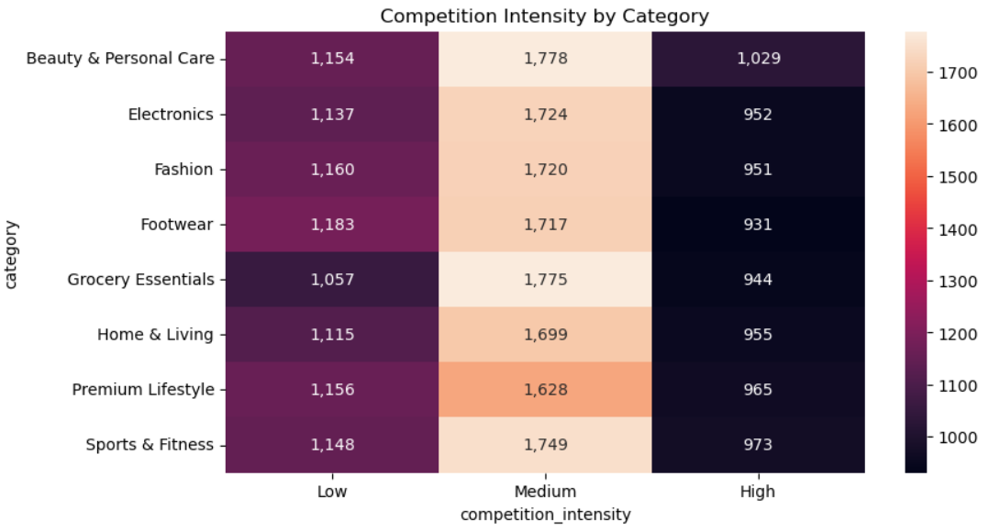
B8. How was the competition intensity among categories?
Medium competition intensity is highest across all categories, with Beauty & Personal Care (1,778) and Grocery Essentials (1,775) leading.
High competition intensity is lowest overall, especially in Footwear (931) and Fashion (951) compared to other levels.

Slide 19
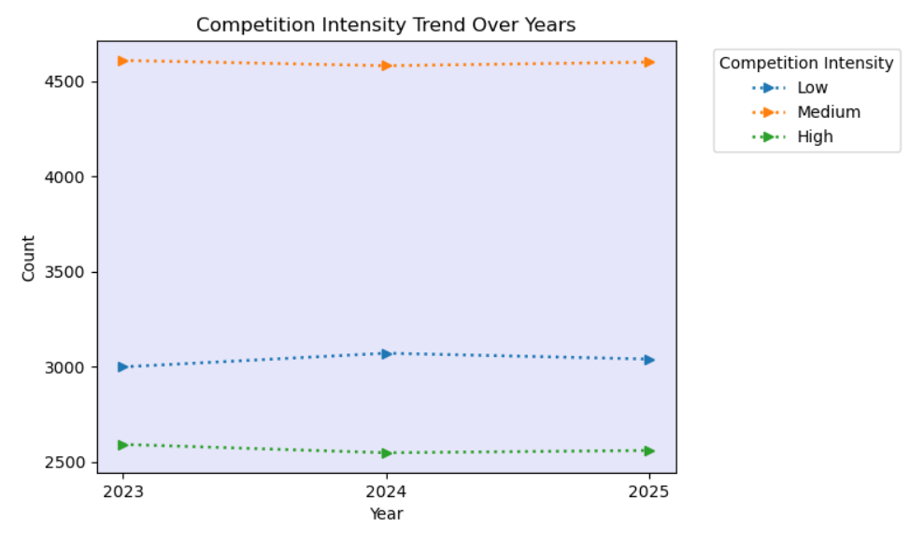
B9. Analyze the competition intensity trend over the years.
Medium competition remains the highest across all three years, showing a slight dip in 2024 and a small recovery in 2025.
Low competition slightly increases in 2024 then marginally declines, while High competition shows a minor drop in 2024 followed by a small rise in 2025.

Slide 20
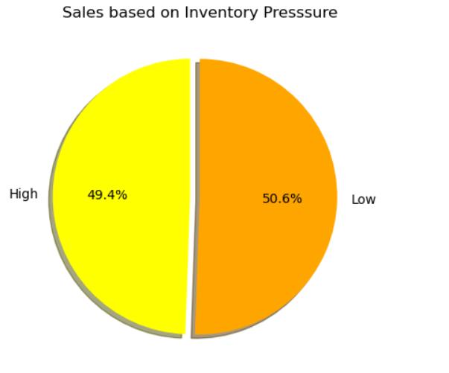
B10. Evaluate how inventory pressure affected revenue performance.
Sales distribution varies based on inventory pressure levels.
Higher inventory pressure likely pushes higher sales through promotions or discounts.

Slide 21
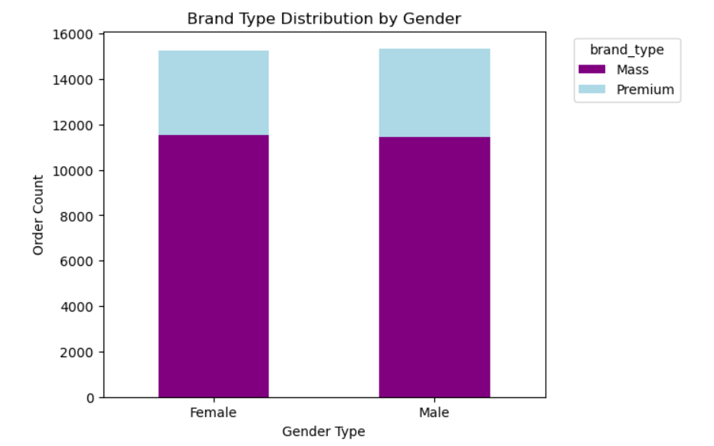
B11. Identify the most preferred and purchased brand type by customer gender.
Mass brand orders dominate for both genders.
Premium orders are lower, with males slightly higher than females overall.

Slide 22
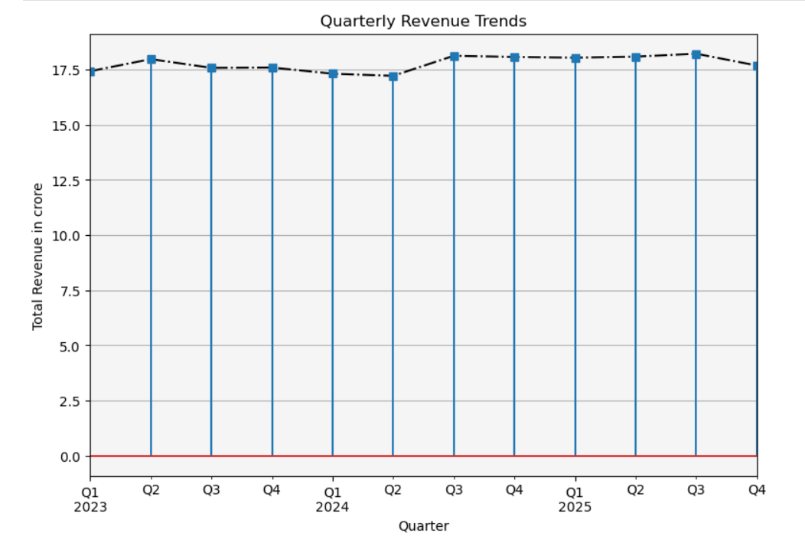
B12. Determine which quarters recorded the highest and lowest sales performance.
Quarterly revenue remains stable around 17–18 crore with minor fluctuations.
A slight peak is seen in mid-2025, showing a modest upward trend overall.

Slide 23
c. Final Key Insights
Revenue is highly concentrated in specific states and zones.
Seasonal trends (monthly & quarterly) significantly impact sales performance.
Discounts play a major role in driving volume-based sales.
Competition intensity affects category performance and revenue growth.
Sales events and inventory pressure strongly influence revenue spikes.
Gender-based brand preference insights can help in targeted marketing.
Strategic regional and seasonal planning can improve profitability.

Slide 24
Thank you
By
M.Abinaya

